Slide 2
Do you have a part time job?
Why might two people that both work for the same organisation have different salaries?
Are those reasons justifiable?
Notes:
Image: https://pixabay.com/photos/money-finance-business-success-2696234/
Ask learners if they have a part time job. Get them to discuss why someone’s salary may be different from someone else's in the same organisation? See what they come up with and get them to feedback as a whole group.
Is it fair that people get paid different amounts? Are there times when it would not be fair?

Slide 3
Which number summarises the wages below?
£177000
£42000
£32000
£18000
£16000
£24000
£18000
£18000
A
£43125
B
£18000
C
£21000
D
£161000
E
None…
Notes:
Ask students to discuss which of the numbers represents the average salary in this company.
A – mean, B – mode, C – median, D – range
Can discuss importance of spread as well as average.
Median is much more representative than the mean and that is why it is used by Office for National Statistics.

Slide 4
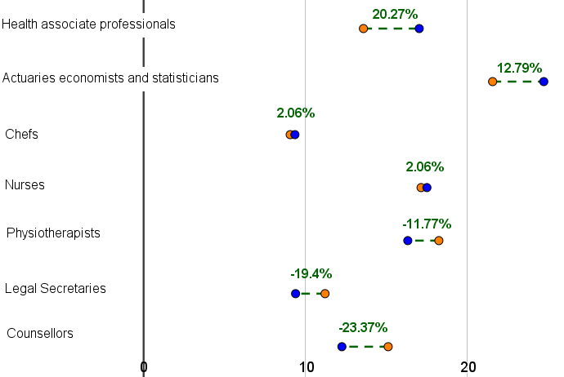
What do you think the red/orange and blue dots represent?
What do you think the percentages represent?
What do you think this graph shows?
Why are Chefs and Nurses the same % but in different positions?
What does a negative percentage mean?
Median Hourly Pay
How could you label this scale?
Notes:
Explain that this graph is taken from the Office for National Statistics (the ONS are the UK’s largest independent producer of official statistics. They are responsible for collecting and publishing statistics related to the economy, population and society at national, regional and local levels. They also conduct the census in England and Wales every 10 years)
What do you think the red/orange and blue dots represent? Women and Men (these colours are from the original graph from the Office for National Statistics and could lead to a discussion about colour stereotyping).
What do you think the percentages represent? Gender pay gap
Why are Chefs and Nurses the same % but in different positions? Higher/lower median hourly salary
May lead on to answering next question.
Median Hourly Pay
What about the scale at the bottom? Median hourly pay
What does a negative percentage mean? Women are paid more than men.
Why have they used median pay rather than mean?
Ask them whether this graph does a good job of displaying the data. Perhaps question if it is better for some people than others.

Slide 5
I need to be honest with you….
This is NOT a representative sample!
Interested in a particular job? Explore figure 5.
What do you think the gender pay gap is across all full time employees in the UK?
Notes:
Link will take you to ONS data and you can find gender pay gap for lots of different jobs in figure 5.
Answer to 3 on next slide.

Slide 6
“The gender pay gap fell to 8.6% among full-time employees in 2018”
What do you think this means?
Women earn 8.6% less per hour, on average, than men.
Notes:
https://www.ons.gov.uk/employmentandlabourmarket/peopleinwork/earningsandworkinghours/bulletins/genderpaygapintheuk/2018
https://pixabay.com/photos/railway-platform-mind-gap-1758208/
Ask students to discuss what this means. E.g. a 8.6% gender pay gap denotes that women earn 8.6% less per hour, on average, than men.

Slide 7
How monkeys respond to unequal pay video
Notes:
Links to TED talk where monkeys react very strongly to unequal pay.

Slide 8
Actuaries, Economists and Statisticians
Women earn a median salary of £21.55 p/hr
Men earn a median salary of £24.71 p/hr
Estimate the difference this would result in annual salary
What about over a working lifetime?
What if you considered tax and National Insurance?
Notes:
https://www.ons.gov.uk/employmentandlabourmarket/peopleinwork/earningsandworkinghours/bulletins/genderpaygapintheuk/2018
https://pixabay.com/photos/railway-platform-mind-gap-1758208/
They may need some guidance on weekly hours and weeks a year worked:
A full-time worker will usually work 35 hours or more a week. Almost all workers are legally entitled to 5.6 weeks’ or 28 days paid holiday a year (known as statutory leave entitlement or annual leave). An employer can include bank holidays (8 in UK) as part of statutory annual leave.
(https://www.gov.uk/holiday-entitlement-rights)
Example working out:
Number of hours worked: 52 x 35 = 1820 (52 because they get paid for their holidays)
Women’s salary: 1820 x 21.55 = 39,221.00
Men’s salary: 1820 x 24.71 = 44,972.20
This is £5751.20 difference each year.
Work for approx 45 years so difference of £258,804 for lifetime
Tax would reduce the gap. Tax rates can be found: https://www.gov.uk/government/publications/rates-and-allowances-income-tax/income-tax-rates-and-allowances-current-and-past

Slide 9
Why study Maths after GCSE?
Stimulating and challenging courses;
Increase knowledge and understanding of mathematical techniques and their applications;
Support the study of other A levels;
Develop key employability skills such as problem-solving, logical reasoning, communication and resilience;
Excellent preparation for a wide range of university courses;
Leads to versatile qualifications that are well-respected by employers and higher education.
Notes:
Image: amsp website

Slide 10
Post-16 Mathematics options
AS/A level Mathematics
AS/A level Further Mathematics
Core
Maths
AS/A level Statistics
Which should you choose?

Slide 11
What are the options?
Core Maths
Develops maths skills and knowledge to focus on applied problem solving
A level Mathematics
Extends GCSE Maths and introduces new ideas
A level Further Mathematics
An additional A level to add breadth/depth
A level Statistics
A specialised course focusing on data analysis

Slide 12
What is Core Maths?
A course that will develop valuable mathematics skills (if you are not planning to take AS or A level Mathematics)
Equal in size to an AS level
An option for any student with at least a GCSE Mathematics grade 4
All about solving maths problems you will face in life and in the workplace
A course that will help you with the maths in your other subjects
A qualification that will help you get into University and can lead to reduced offers

Slide 13
Main Content of Core Maths
Financial Maths
Statistics & Probability
Critical Analysis
Modelling (spreadsheets)
Estimation
Notes:
https://pixabay.com/photos/money-finance-mortgage-loan-2696229/
https://pixabay.com/illustrations/dices-over-newspaper-profit-2656028/
Real rates from real banks, Exchange rates, commission and buy/sell rates. Taxation.
Interpretation is essential. Probability often connected with the idea of ‘risk’.
Do the figures support…? Use the data to defend… Why is the tax calculation wrong?
: Practical approximation. Fermi estimation.

Slide 14
Core Maths style problems
How much domestic water does the UK require every year? | A newly qualified teacher earns £23,000 per year, has no student loans, and pays 7.4% of their salary into a pension scheme. What is the teacher’s net monthly salary after tax and national insurance contributions?
A genetic disease occurs in one in every 10,000 people. A test for the disease is accurate 98% of the time. If you are tested and the result is positive, what are the chances of you actually having the disease? | The speed of cars driving down a road with a speed limit of 50mph is recorded. The mean speed was 47mph and the standard deviation of the speeds was 5mph. What percentage of the cars were breaking the speed limit?
Notes:
Water drop image from https://openclipart.org/tags/water-drop

Slide 15
Contact the AMSP
01225 716 492
admin@amsp.org.uk
amsp.org.uk
Advanced_Maths

Slide 16
About the AMSP
A government-funded initiative, managed by MEI, providing national support for teachers and students in all state-funded schools and colleges in England.
It aims to increase participation in AS/A level Mathematics and Further Mathematics, and Core Maths, and improve the teaching of these qualifications.
Additional support is given to those in priority areas to boost social mobility so that, whatever their gender, background or location, students can choose their best maths pathway post-16, and have access to high quality maths teaching.

